Slide 1
Cell Biology: Data Workshop 2
Comparing morphological parameters of clonal hMSCs
BIO00066I: Becoming a Bioscientist 4: Research in Action
Dr Amanda Barnes and Dr Daniel Jeffares
Check in: XXXXXX

Slide 2
Learning Outcomes for today’s session
Explain how the Livecyte data set was collected and what metrics it contains
Apply RStudio skills to import, manage and explore the Livecyte data set
Compare which morphological parameters differ between clonal lines
Create plots to assist in exploring and interpreting the data
Apply appropriate statistical methods to analyse the data
Interpret data with care
Integrate knowledge from laboratory work and computational analysis
Notes:
How to make your data analysis reproducible and well-explained
Thinking like a data scientist
How to interpret data with care
How to integrate knowledge from laboratory work and computational analysis

Slide 3
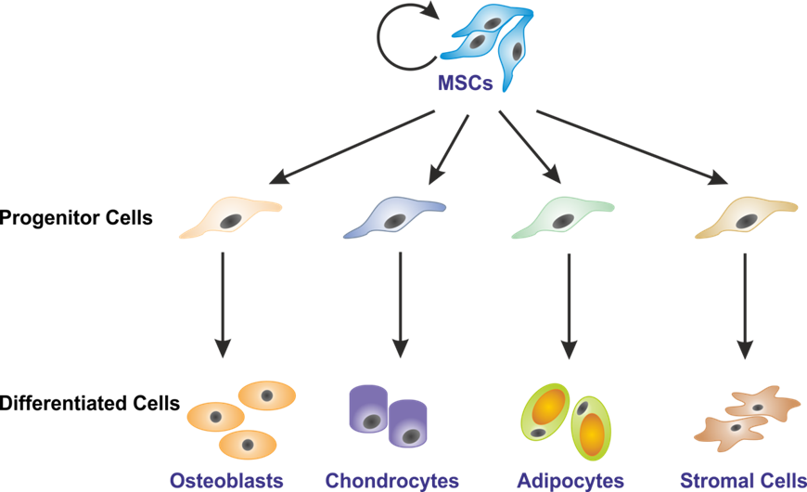
MSCs vary in their potential to differentiate
Not all MSCs are equal! They are a mixed population (heterogenous) of cells ranging from tripotent to nullipotent
Clonal lines (lines of cells derived from a single stem cell) are used to investigate heterogeneity

Slide 4
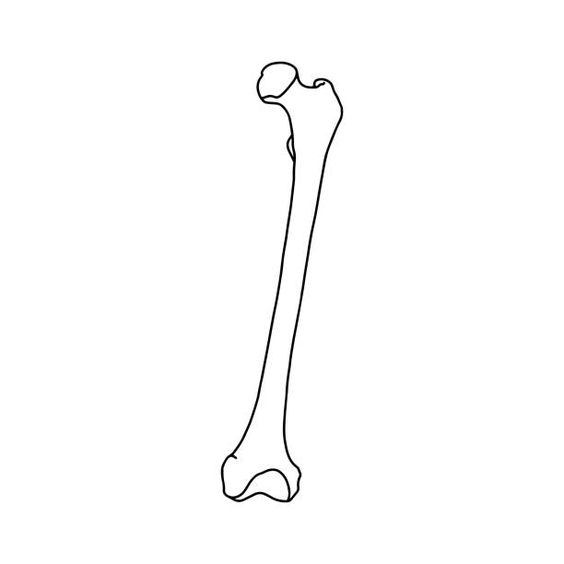
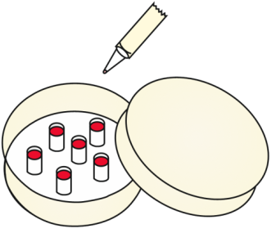
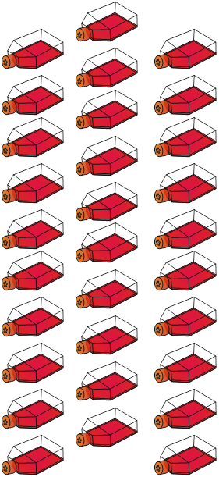

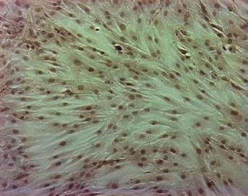
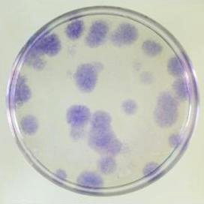
Model hMSC cell lines: Immortalised clonal lines
Human MSCs obtained from Femoral head
MSC clones isolated and expanded
Immortalised MSC bank
MSCs transduced with telomerase
MSCs extracted
Transduced MSCs plated at low density
Clonal line A
Clonal line B
Notes:
Isolated a heterogenous population of adherent BM – MSCs from a femoral head of donor undergoing a routine hip replacement.
Lentivirus was used to transduce overexpression of hTERT into the cells and then clonal lines were selected by plating at low density and isolation with cloning cylinders
clonal lines focused upon were selected as they displayed stable growth characteristics

Slide 5

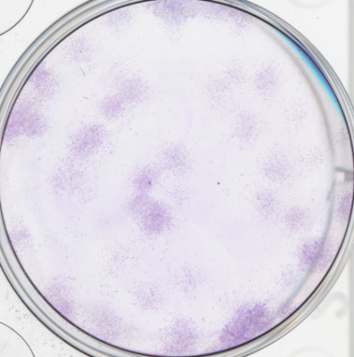
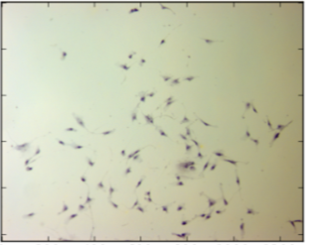
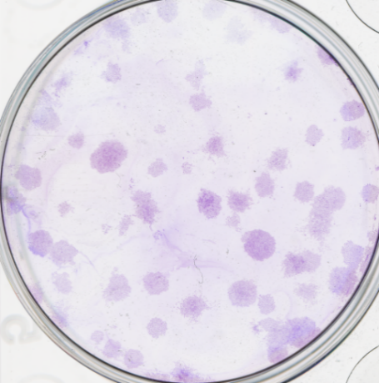
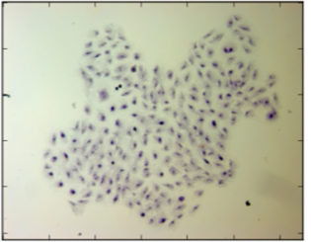
MSC clones vary in their shape and movement
Crystal Violet Stain
Dispersed
Fibroblastoid
Clone A
Compact
Large, spread
Clone B
Research Question: Can cell shape and movement predict the capacity of an MSC to differentiate (potency)?
Notes:
In-vitro analysis of MSC migration of clonal lines appears to show variation in cell shape and migration - could this be a useful property to identify MSC subtypes if it correlated with stem cell potency?

Slide 6
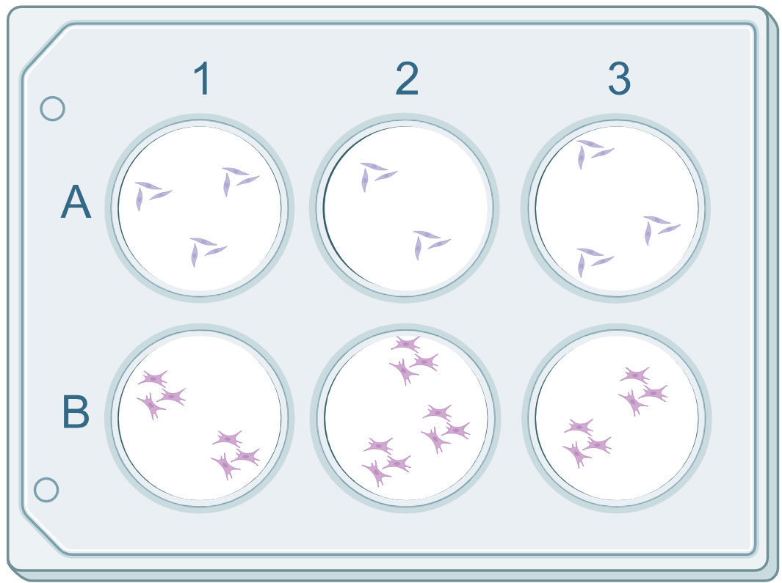
How the data sets were collected
Clone A and B seeded at clonal density (single isolated cells)
Two days later the cells were transferred to the LiveCyte microscope and regions of interest (ROI) selected that contained small colonies (1900 um²)
An image was taken of each ROI every 23 minutes for 4 days
Livecyte software uses diffraction patterns to build an image stack for ROI

Slide 7
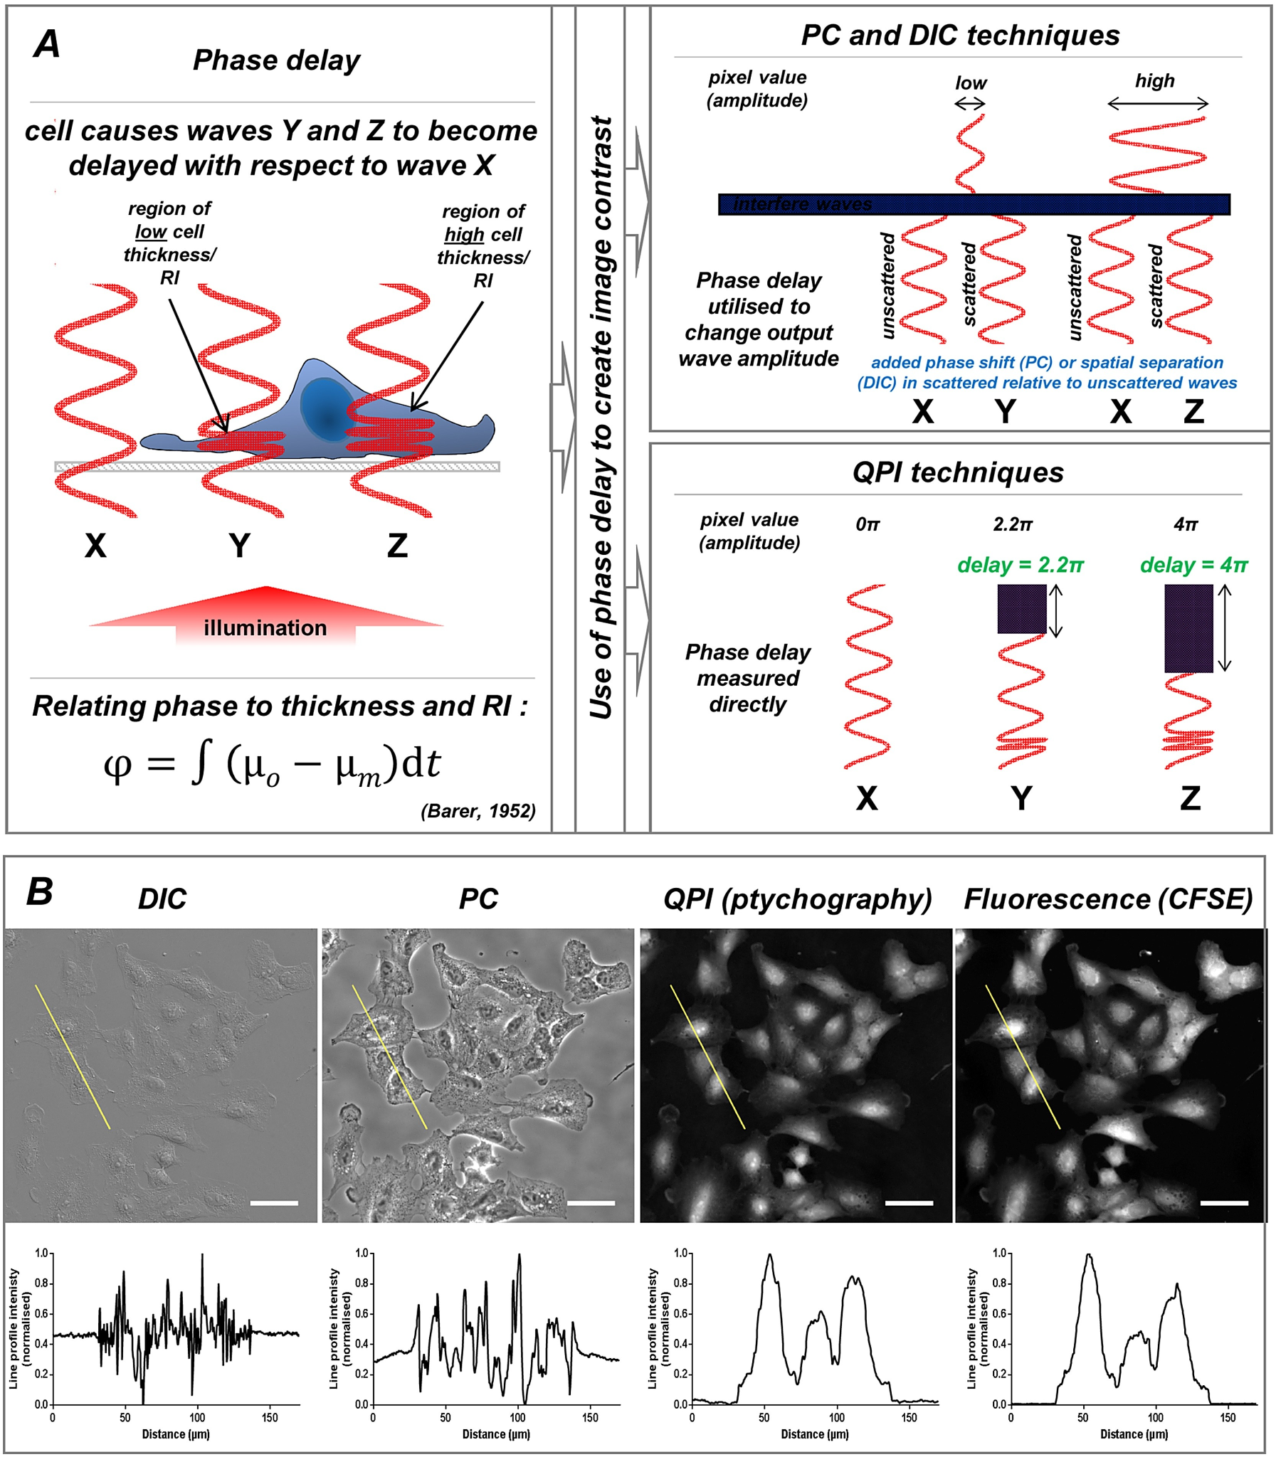
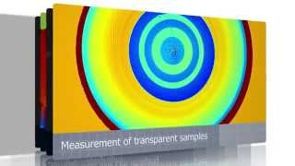
Quantitative Live Cell Imaging - LiveCyte
Creates images through Quantitative Phase Imaging – where the refractive index and thickness variations in cells causes a phase delay in the light
Diffraction patterns are processed in PF algorithm to create images
Notes:
Sample is illuminated by a laser, the beam is scattered when it contacts the cells and creates a diffraction pattern. The diffraction patterns are processed by an algorithm to obtain quantitative information about the cells. The software uses the delay in beams passing through different parts of the cells to create a quantitative map of the sample being imaged.
Label free live cell imaging - cells appear as bright images on a dark background
https://www.nature.com/articles/srep02369
https://www.sciencedirect.com/science/article/pii/S1357272517300055

Slide 8
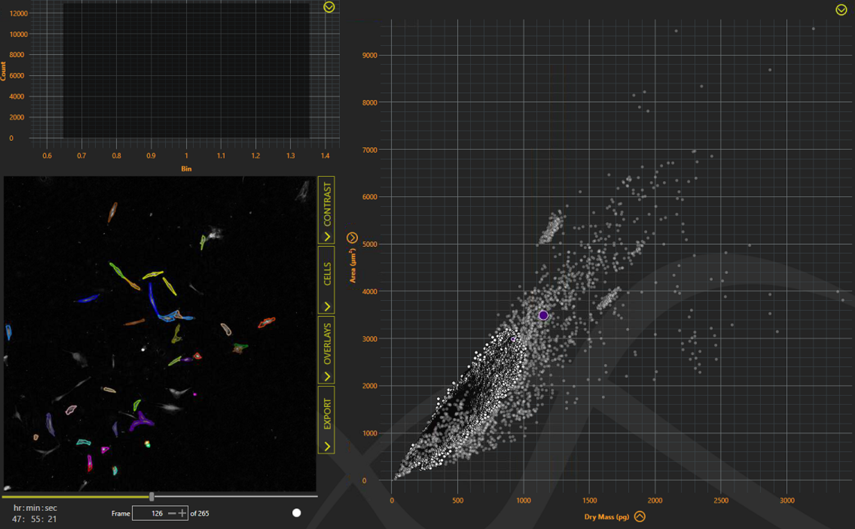
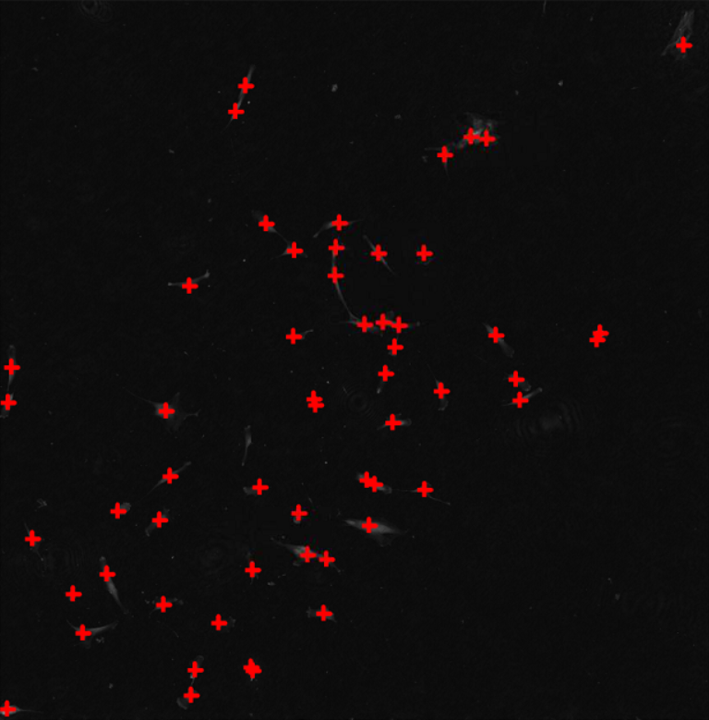
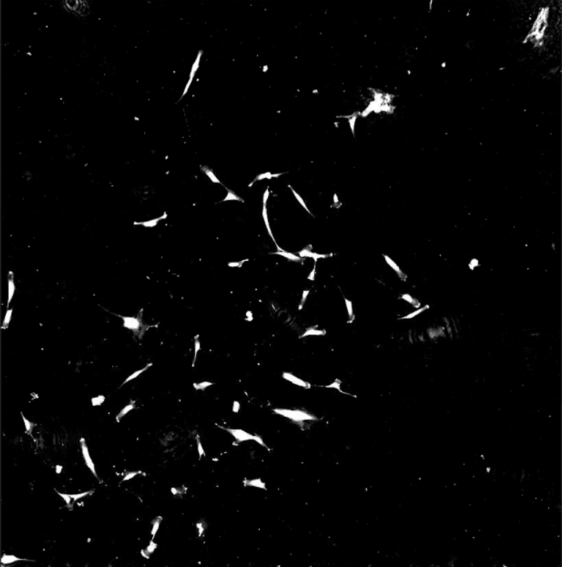
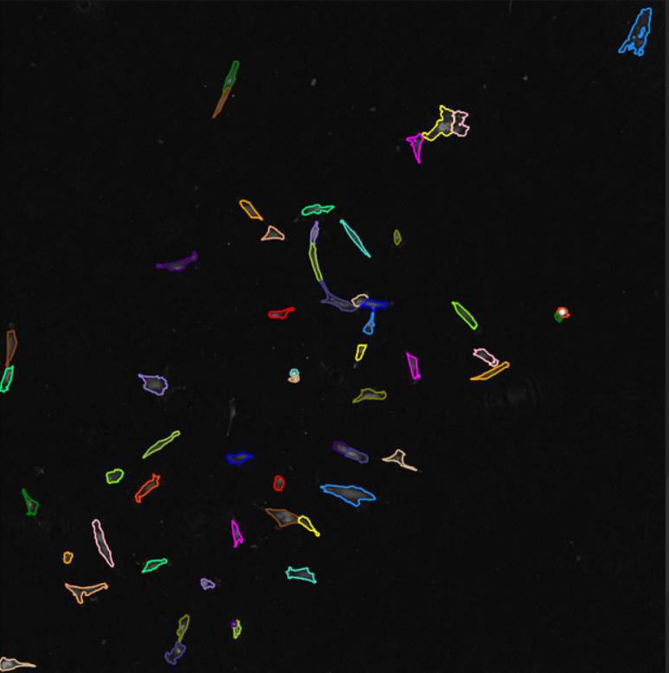
Preliminary analysis of data sets
Identify individual cells
Distinguish cells from background
Segment individual cells
Remove cell aggregates

Slide 9
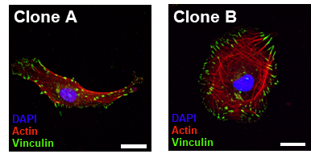
How does the morphology differ between clone A and B?
Qualitative analysis of the morphology of different MSC clone. Investigating the cell size, shape and actin cytoskeleton between clones A and B
P1 - Cell Culture (detaching, counting and plating cells)
P2 - Fixing and staining cells
P3 - Fluorescent Microscopy
Quantitative analysis of cell morphology (size, shape) and migration from Livecyte big data set of clone A and B
Data Workshops 2 - 3
How do the hMSC clones differ in morphology?
Can the metrics distinguish between clones A and B?
Representative images, you won’t stain for Vinculin

Slide 10
Dataset Metrics
Calculated using the pixels in the image and phase delay caused by the refractive index from different features in the cell
Mean Thickness (μm) - Total volume divided by total area of the cell
Radius (μm) - the radius of a circle that has the same segmented area as the cell
Sphericity - How round the cell is by comparing the surface area to a sphere of the same volume (0 = flat, 1 = round)
Length and Width (μm) - The length and width of the smallest box that could contain the segmented cell
Dry Mass (pg) - Estimated non-water mass of the cell
Length to width - Ratio of length to width
Also Volume (μm³), Area (μm²), Perimetre (μm)

Slide 11
What do I need to do next week?
Complete the preparatory work for Practical 1
Read through practical handout and watch introductory video
Review the concepts and data analysis in this workshop and complete the consolidation exercise
Attend Practical 1

